Slide 1
Science with Dr. Christina Rahm We will get started shortly.

Slide 2
Medical Disclaimer:
The information provided is for educational purposes and is not intended as medical advice, or a substitute for the medical advice of a physician or other qualified health care professional. You should not use this information for diagnosing a health or fitness problem or disease. You should always consult with a doctor or other health care professional for medical advice or information about diagnosis and treatment.
Notes:
The information provided is for educational purposes and is not intended as medical advice, or a substitute for the medical advice of a physician or other qualified health care professional. We do not aim to diagnose, treat, cure or prevent any illness or disease. You should always consult with a doctor or other health care professional for medical advice or information about diagnosis and treatment. The information in this presentation has not been evaluated by the Food & Drug Administration or any other medical body.

Slide 3
Dr. Christina Rahm CEO & Chief Science Officer

Slide 4
ISNS Case Study Presented by: Dr. Christina Rahm

Slide 5
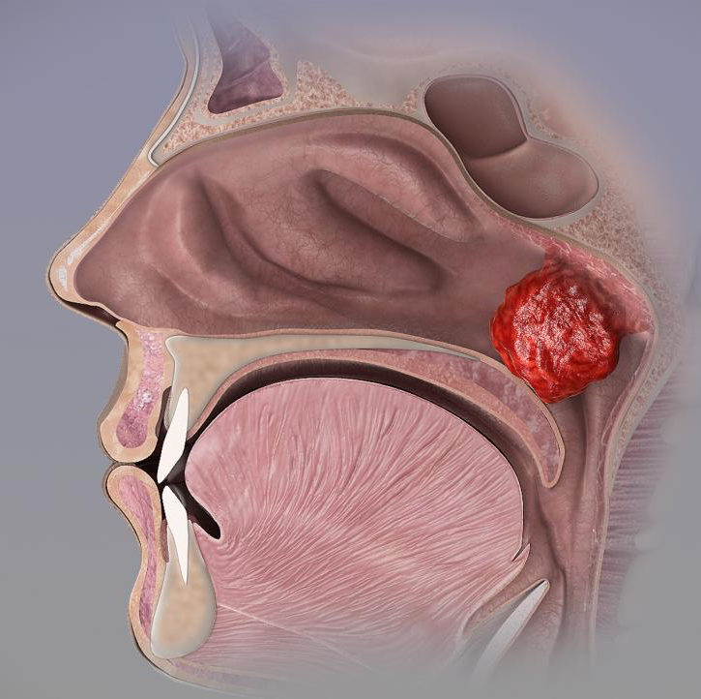
Adenoid Hypertrophy
Adenoid hypertrophy is an obstructive condition and can occur with or without an acute or chronic infection of the adenoids—a part of the lymphatic system, a patch of tissue, just behind the nose. This condition is more prevalent in children, but it has been reported to regress with age. Due to age related adenoid deterioration, this condition can resolve on its own; however, it can lead to serious complications.

Slide 6
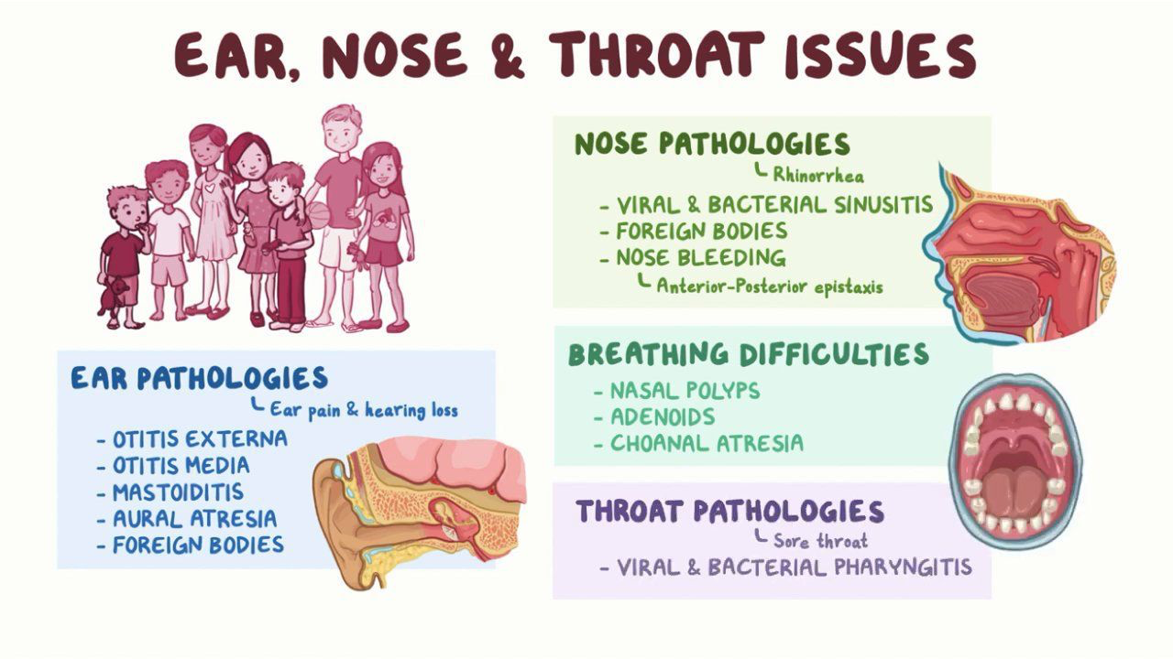
DIAGNOSIS AND TREATMENT OF ADENOID HYPERTROPHY
These complications can cause significant nasal obstruction leading patients to complain of difficulty breathing through the nose, post-nasal drip, chronic cough, snoring, excess nasal drainage, and/or sleep-disordered breathing in children. More severe patients can suffer from sinusitis. Typically, the first step for treating this condition in acute and chronic infectious adenoid hypertrophy is with antibiotics. For patients with recurrent obstructive or infectious symptoms related to this condition, an adenoidectomy—the surgical treatment option choice for adenoid hypertrophy—is suggested. This surgical option is preformed to reduce or completely eliminate the adenoid tissue.

Slide 7
PROPRIETARY BLENDS LEGEND
Proprietary blend I: Silica, Vitamin C, and Trace Minerals
Proprietary blend II: N-acetyl L-tyrosine, Anhydrous Caffeine, L-theanine, Velvet Bean Seed, Pine Bark, Curcumin, and Vitamin D
Proprietary blend III: Black seed oil, Resveratrol, turmeric, Raspberry Ketones, Apple Cider Vinegar, Aloe Vera, and D-Ribose
International Science and Nutrition Society – CURARE CAUSAM – ISNS 2021

Slide 8
ISNS CASE STUDY I
Patient: Male
Age: 4-year-old
History: A 4-year-old male with primary diagnosis of hypertrophy of the adenoid gland but also signs of eczema. He also experienced long-lasting colds accompanied with mucus discharge, that were occurring every month. He was often also constipated. Parents reported he was snoring at night and that they planned to have an ENT removal (adenoid removal).
Treatment/ Method: He was put on functional medicine gut healing protocol including elimination diet and inflammation reducing supplements, also using Proprietary blend 1 drops 1 drop B.I.D, we slowly increased in 2 months to 3 drops B.I.D.
Results: In less than a month his skin was without any signs of eczema, his stool was normal. He didn’t catch any cold in 2 months. A minor one was reported after 2 months, but without any episodes of snoring. Snoring completely resolved. He will have an ENT exam, checking his adenoid status.
No side effects were reported.
International Science and Nutrition Society – CURARE CAUSAM – ISNS 2021

Slide 9
PROPRIETARY BLEND I SILICA/ZEOLITES, VITAMIN C , AND TRACE MINERALS
International Science and Nutrition Society – CURARE CAUSAM – ISNS 2021

Slide 10
VITAMIN C
One of the most important nutrients, it is thought that high levels of vitamin C (ascorbic acid) may rid the body of toxins. Vitamin C is believed to:
Have anti-aging properties
Boost the immune system
Help the body absorb materials
Protect the body from harmful chemicals
Help the body ward off infection
Boost the body’s vitamin C stores
Leave the body feeling refreshed and energized

Slide 11
VITAMIN C & ADENOID HYPERTROPHY
In a study, 10 healthy, untreated patients with obstructive sleep apnea, a symptom of Adenoid hypertrophy, were subjected to injection of vitamin C; the results showed that baseline flow-meditated dilation of the brachial artery were significantly reduced in the patients with obstructive sleep apnea. These results are in favor of oxidative stress being responsible for the endothelial dysfunction in OSA.
https://pubmed.ncbi.nlm.nih.gov/16439717/
To evaluate vitamin c’s ability to treat the common cold, 45 patients (25 women and 20 men) received 6.0 g of vitamin C daily. Within 24 hours of the first symptom od the disease, the duration of cold was significantly decreased.
https://www.mv.helsinki.fi/home/hemila/CC/Asfora_1977_ch.pdf
International Science and Nutrition Society – CURARE CAUSAM – ISNS 2021

Slide 12
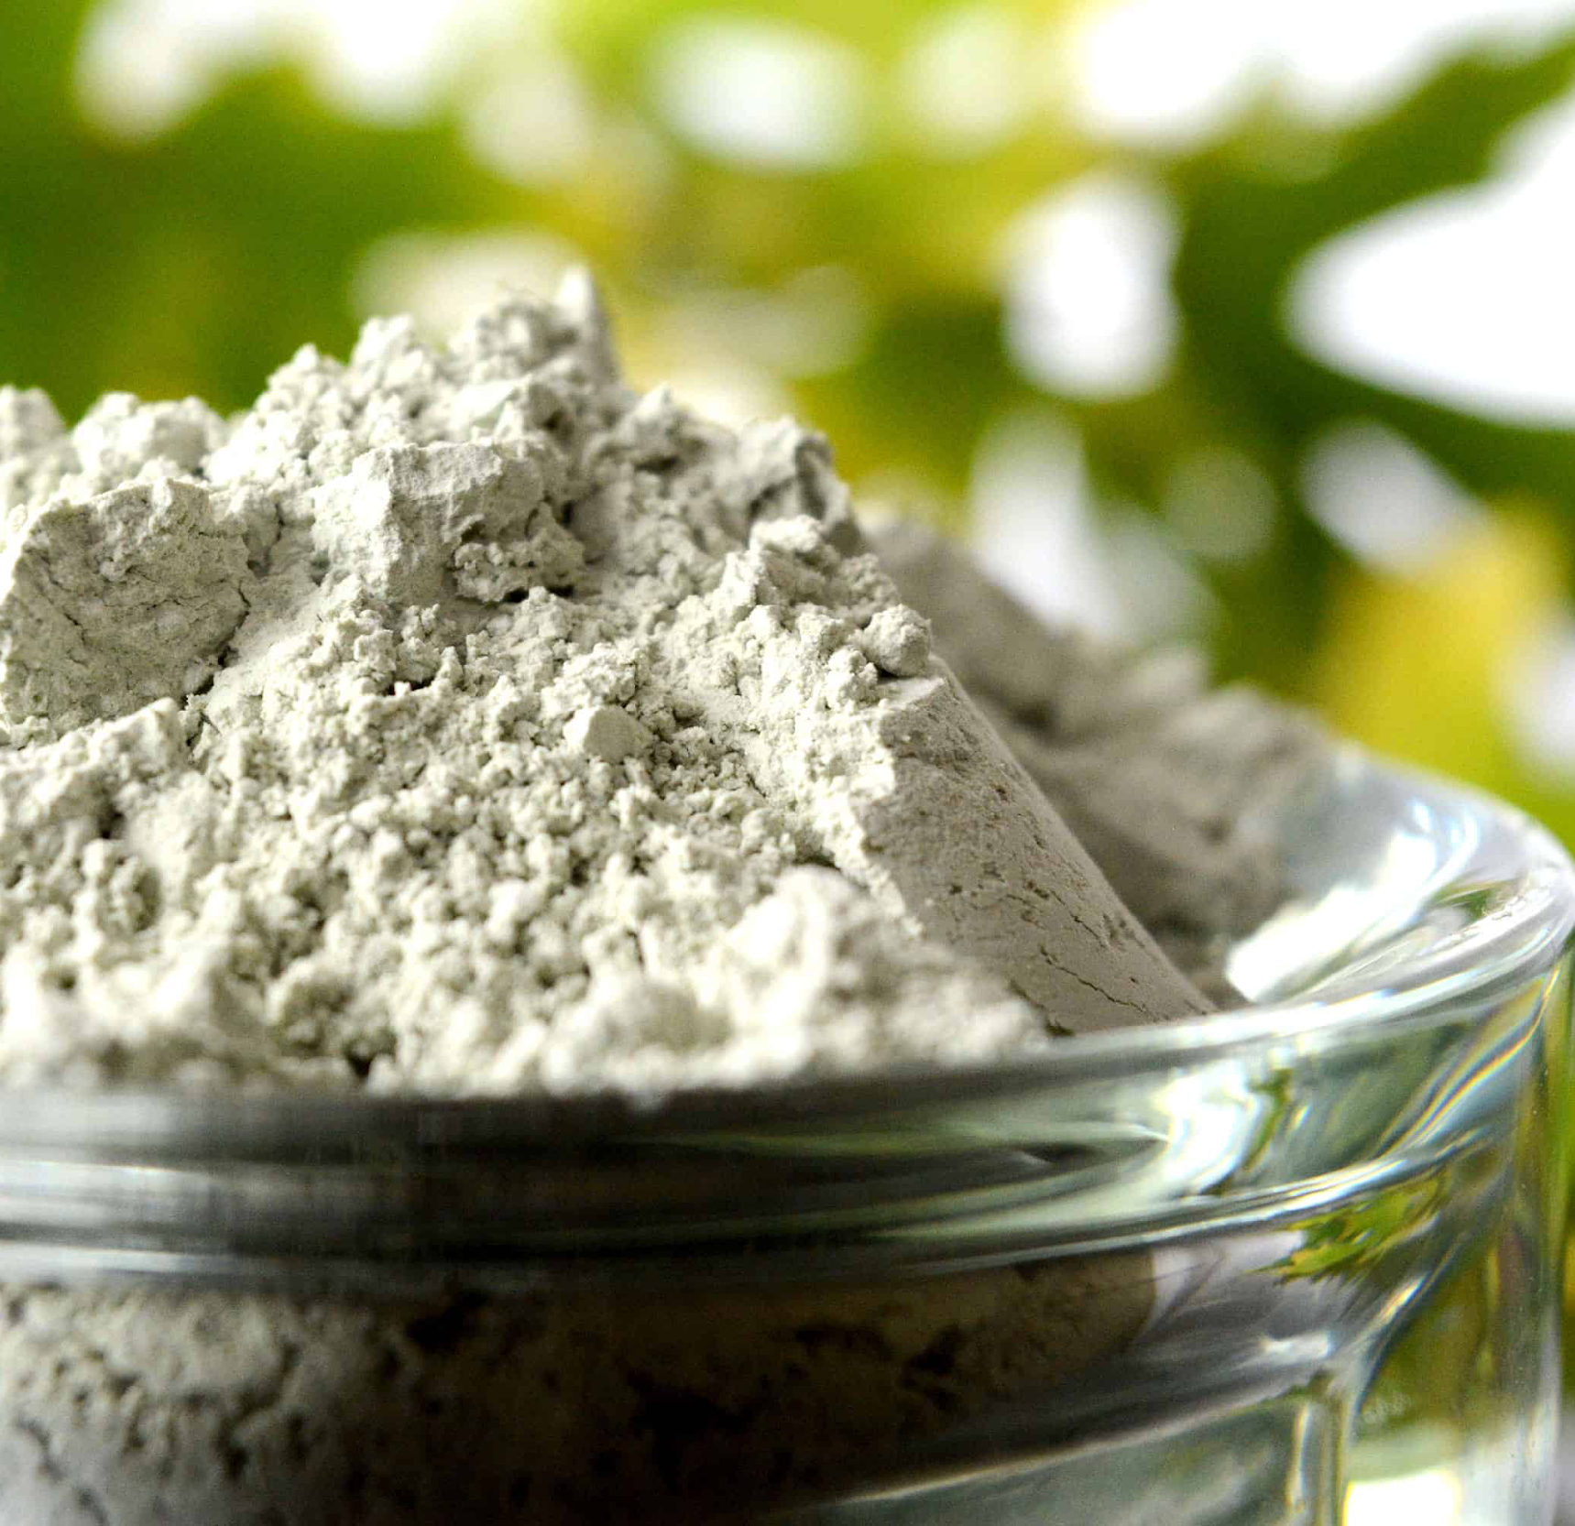
SILICA
Silica or silicon dioxide has been proven to help in the elimination of various containments from the the body. By removing toxins, chemicals, pesticides, & heavy metals from the body, silica may:
Promote hair, skin,& nail health
Improve joint & bone health
Enhance heart health
Reduce digestive disorders
Boost the immune system
Hasten the healing process

Slide 13
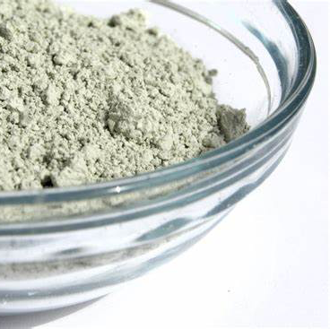
SILICA/ZEOLITES & ADENOID HYPERTROPHY
In one study, after the administration of zeolite clinoptilolite, there was an increase in specific immune cell counts, CD19C B-lymphocytes, CD4C T-lymphocytes, and HLA-DRC activated T-lymphocytes were also observed in patients treated for immunodeficiency
In chickens receiving daily ZC in food, antioxidant capacity was increased by reducing the free radical content of intestinal nitric oxide and increasing the activity of GSH, catalase and SOD enzymes.
https://www.ncbi.nlm.nih.gov/labs/pmc/articles/PMC6515299/

Slide 14
TRACE MINERALS
Trace minerals are essential nutrients that the body cannot produce itself. We only need very small amounts, but they are crucial for our health. Benefits of some trace minerals:
Zinc: boost the immune system and metabolism function
Iron: boost hemoglobin & immunity and reduces fatigue & bruising
Boron: essential for energy utilization
Iodine: boost metabolism and cognitive thinking
Manganese: strengthening bones and ligaments
Molydbenum: process proteins and DNA
Selenium: prevent oxygen damage to the cell membrane
Silicon: formation of collagen

Slide 15
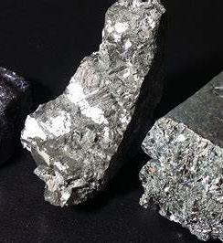
TRACE MINERALS & ADENOID HYPERTROPHY
A study investigated the selenium, zinc, and copper levels in the plasma of 60 children (30 healthy, 30 with AH) with adenoid hypertrophy (AH). The plasma C-reactive protein (CRP) and Cu levels were significantly higher, and the plasma Se and Zn levels significantly lower, in the group with AH than the healthy group.
https://www.tkb.dergisi.org/pdf/pdf_TKB_322.pdf
Researchers investigated the concentrations of trace minerals in 44 patients with obstructive sleep apnea (OSA) and 20 without OSA. The results showed that OSA patients had lower concentrations of plasma Zn and erythrocyte Se and higher plasma concentrations of Cu and Fe. In addition, OSA patients had significantly higher plasma concentrations of hs-CRP, TNF-α, and malondialdehyde (MDA), and lower erythrocyte antioxidant enzyme glutathione peroxidase (GPx) and superoxide dismutase activities.
https://link.springer.com/article/10.1007/s12603-013-0023-x

Slide 16
References
https://pubmed.ncbi.nlm.nih.gov/16439717/
https://www.mv.helsinki.fi/home/hemila/CC/Asfora_1977_ch.pdf
https://www.tkb.dergisi.org/pdf/pdf_TKB_322.pdf
https://link.springer.com/article/10.1007/s12603-013-0023-x
https://www.ncbi.nlm.nih.gov/labs/pmc/articles/PMC6515299/
https://www.ncbi.nlm.nih.gov/books/NBK536984/
https://www.osmosis.org/answers/adenoid-hypertophy
International Science and Nutrition Society – CURARE CAUSAM – ISNS 2021

